Slide 1
Cab Service

Slide 2
Capstone Project – Cab Booking System (MERN Stack + AI Enhancements)
Project Repository:
https://github.com/Kaleakash/car_booking_mern_stack_with_AI_tools_Project.git

Slide 3
Project Overview
- A MERN stack-based real-time Cab Booking System
- Features enhanced using Generative AI tools
- Fully functional frontend, backend, and payment integration
- GitHub repository provided for virtual lab deployment

Slide 4
Technology Stack
- Frontend: React.js
- Backend: Node.js + Express.js
- Database: MongoDB
- Version Control: Git + GitHub
- AI Tools: Uizard, GitHub Copilot, ChatGPT, TestRigor
- Payment Gateway: Stripe (Test Mode)

Slide 5
Project Setup Instructions
**Backend:**
- Clone project from GitHub
- Update db.js with MongoDB URL
- Run: npm install --force
- Start backend: npm start
**Frontend:**
- Navigate to frontend folder
- Run: npm install
- Start frontend: npm start

Slide 6
Project File Structure
- db.js: MongoDB connection config
- models/: Schema definitions
- routes/: API endpoints
- server.js: Main entry file
- frontend/: React application

Slide 7
User Journey
1. User Registration/Login
2. Dashboard Access
3. Admin: Add New Cars
4. User: Select Pickup/Drop Date
5. Choose Driver → Proceed to Payment
6. Payment (Stripe Test Mode)
7. View Booking Confirmation

Slide 8
Stripe Payment Integration
- Fake Card: 4242 4242 4242 4242
- Expiry: 12/28, CVV: 123
- Booking details confirmed after test payment
- Uses Stripe's test environment

Slide 9
Adding Gen AI UI via Uizard
1. Capture screenshot of React login page (.png/.jpg)
2. Go to https://uizard.io
3. Start new project → Upload Screenshot
4. Use Auto Designer to enhance UI

Slide 10
AI-Assisted Coding
Using GitHub Copilot & ChatGPT:
- Auto-generate component logic
- Example: getCabAvailability = async () => {}
- Use prompts like:
“Generate Mongoose schema for car booking”
“React + Stripe payment component”

Slide 11
AI-Powered Testing using TestRigor
1. Visit: https://testrigor.com
2. Sign Up → Confirm Email
3. Connect local/cloud URL
4. Use Natural Language test script:
- “Login as user…”
- “Search for cabs…”
- “Make payment with test card…”

Slide 12
Sample Natural Language Test Case
Go to "http://localhost:3000"
Enter "steven@gmail.com" into "Email"
Enter "steven@123" into "Password"
Click "Login"
Click "Book a Cab"
Enter "Mumbai" into "Pickup Location"
Enter "Pune" into "Drop Location"
Click "Search"
Click "Select" on first car
Click "Proceed to Payment"
Enter Card: "4242 4242 4242 4242", Expiry: "12/28", CVV: "123"
Click "Pay"
Verify "Booking Confirmed"

Slide 13
AI Tools Summary
🛠 Tool | 🔍 Purpose
GitHub Copilot | Auto-suggest code & logic
ChatGPT | Code generation & debugging
Uizard | UI design improvement from image
TestRigor | Natural language test creation

Slide 14
This project present in git repository in below URL
https://github.com/Kaleakash/mern_stack_running_capstone_project.git
Plz login to virtual lab and clone this project in virtual lab using command as
https://github.com/Kaleakash/mern_stack_running_capstone_project.git

Slide 15
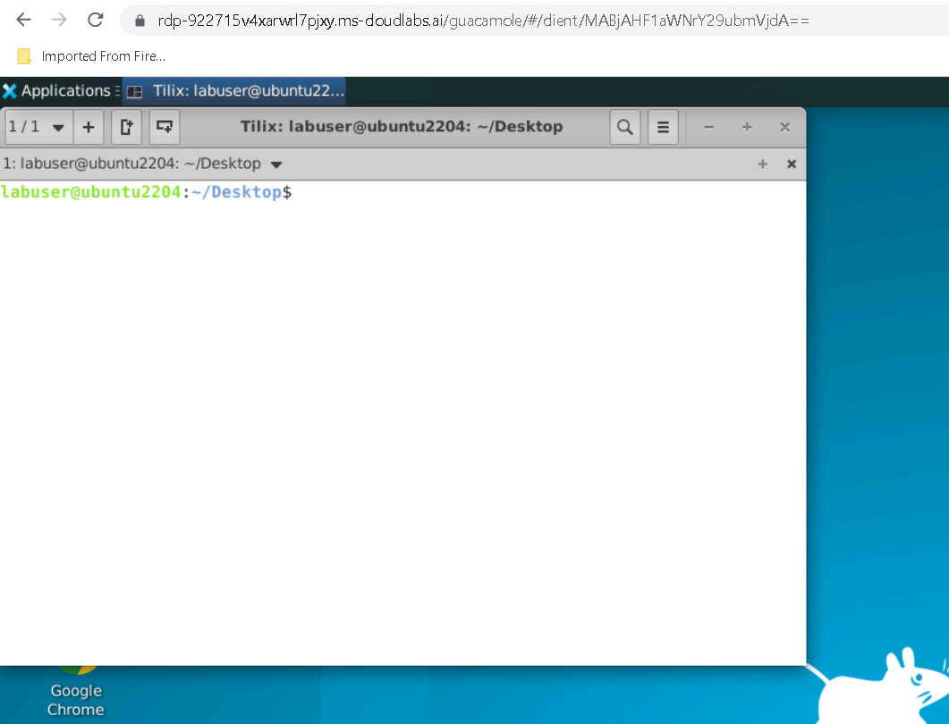

Slide 16
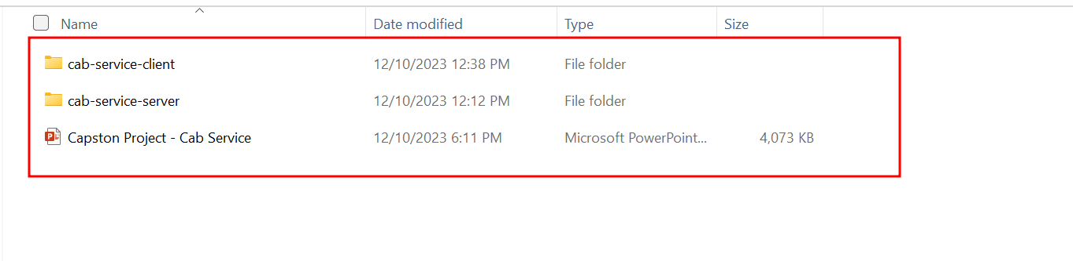

Slide 17
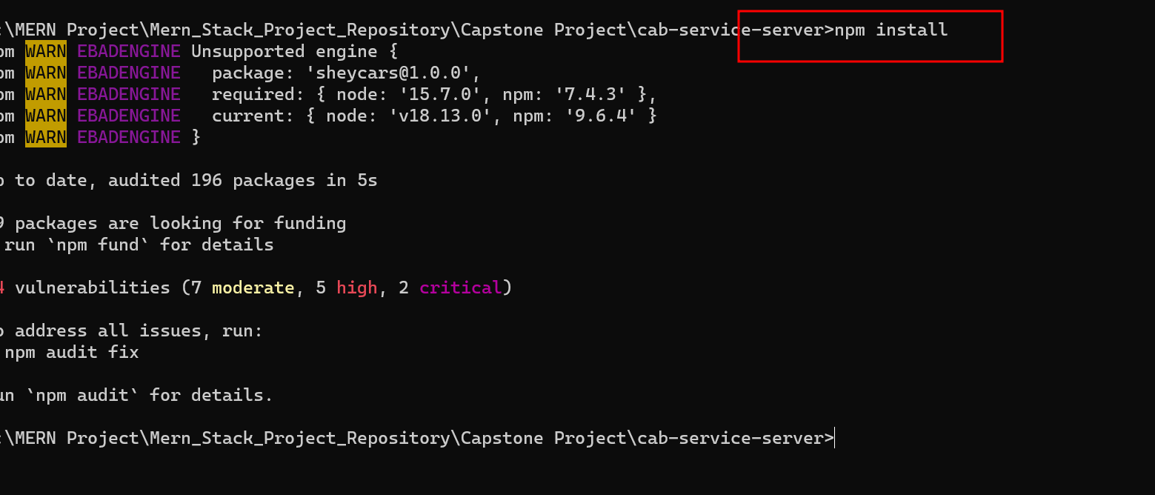

Slide 18
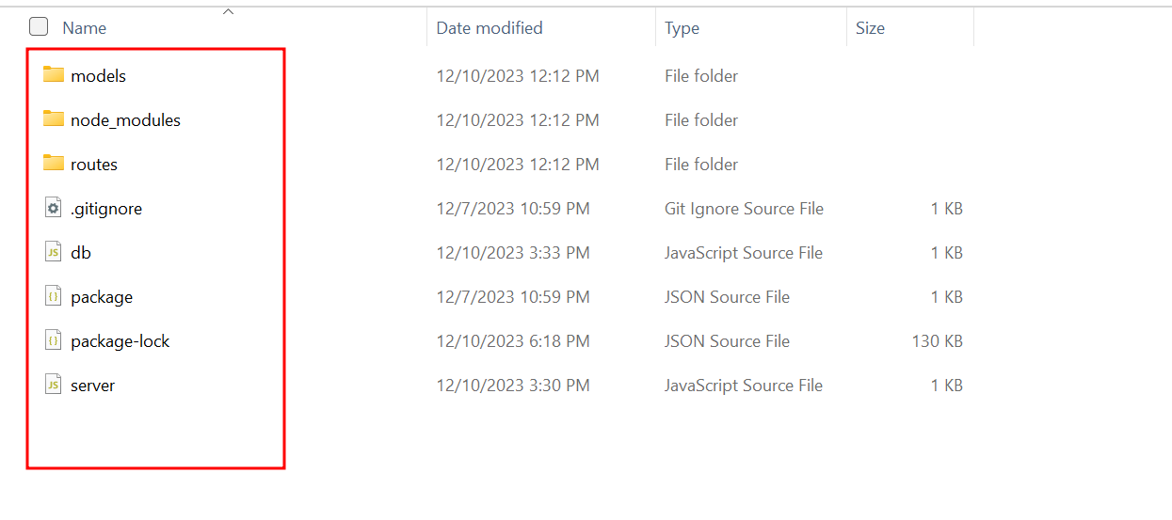
Project structure

Slide 19
Project structure explanation
In db.js file we can see the database connection details. If we use local machine database then ip address must be local host or 127.0.0.1 with port number 27017. database name is infer_car_db.

Slide 20
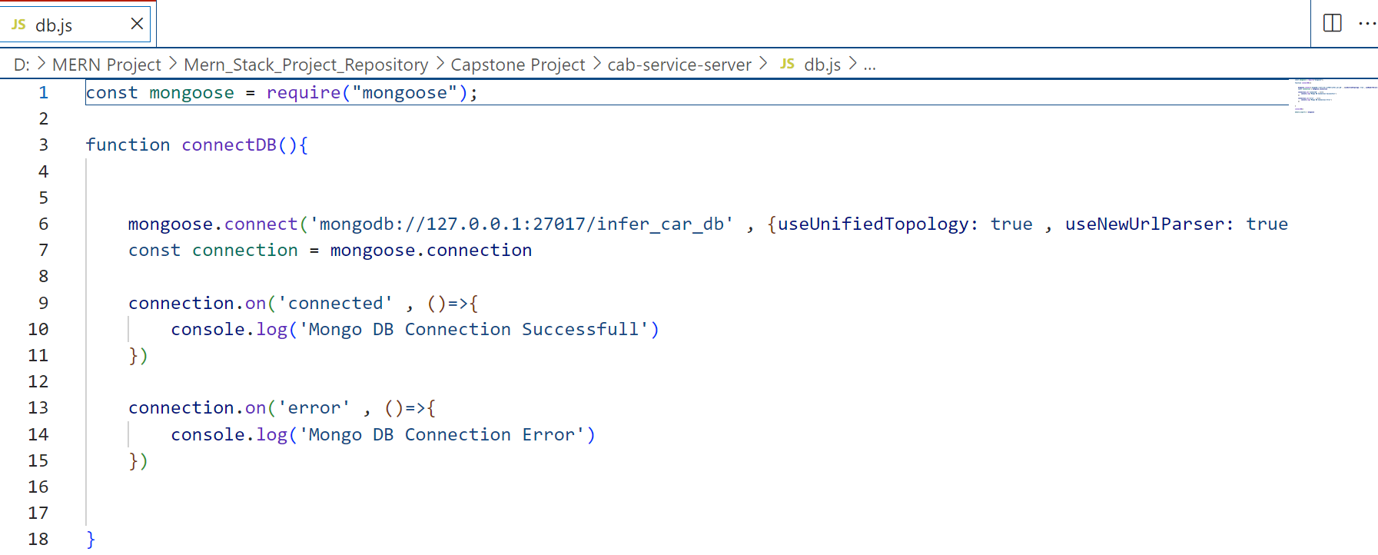

Slide 21
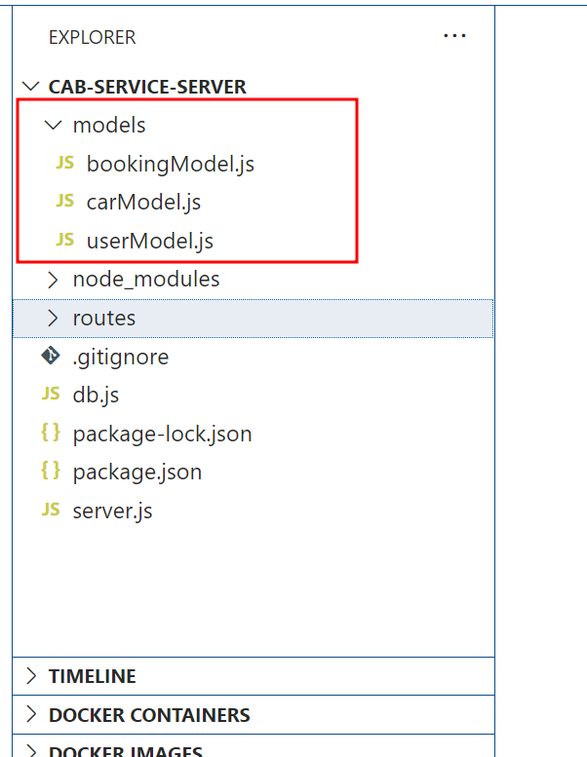
Model file: this file contains the structure of collection with schema definition

Slide 22
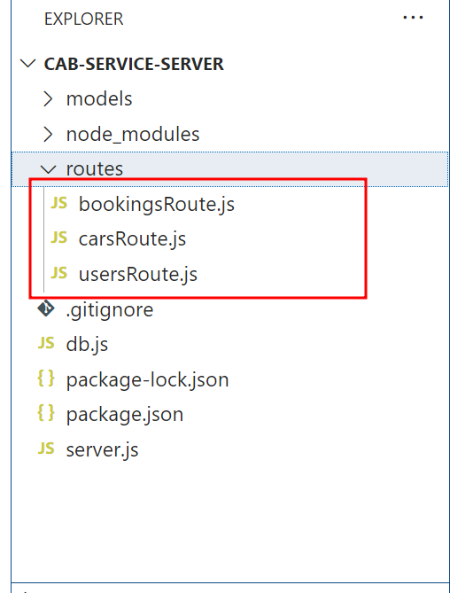
routes file: this file contains the structure of collection with schema definition.

Slide 23
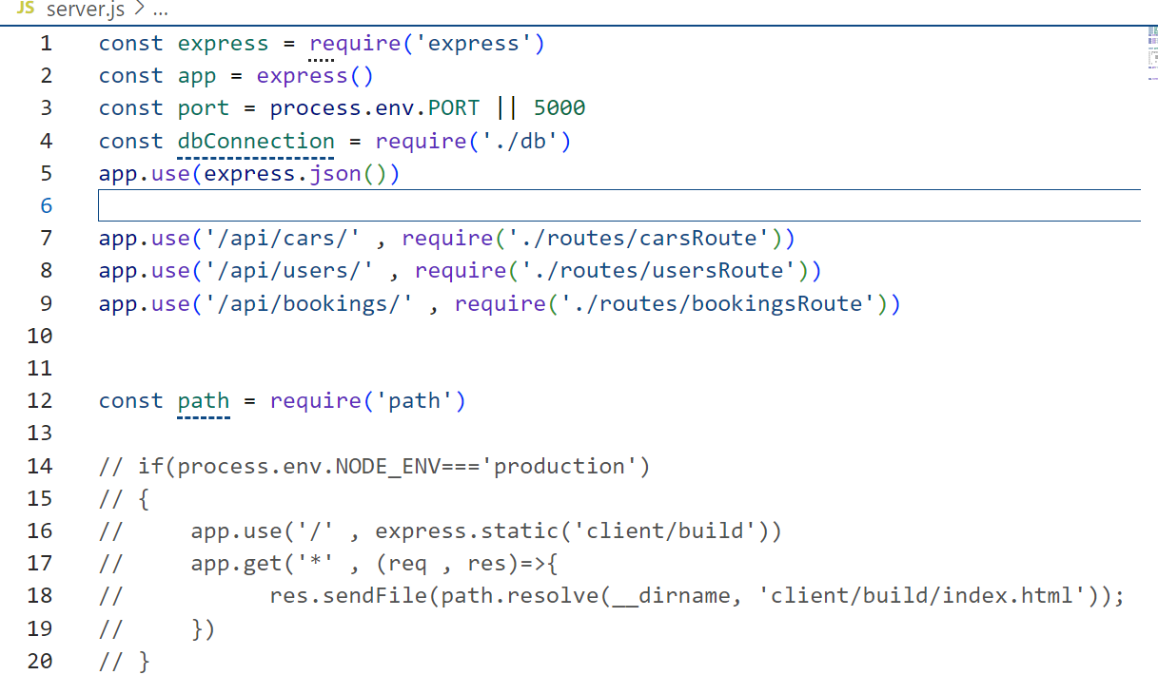
server.js file: this file contains the entry of the program with port number.

Slide 24
Duppy secret key for payment
sk_test_51IYnC0SIR2AbPxU0EiMx1fTwzbZXLbkaOcbc2cXx49528d9TGkQVjUINJfUDAnQMVaBFfBDP5xtcHCkZG1n1V3E800U7qXFmGf

Slide 25
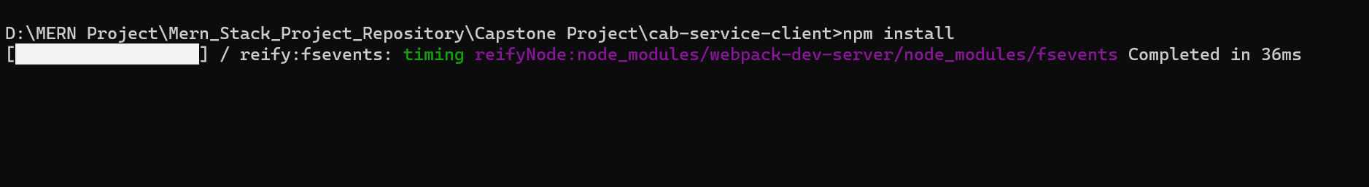
Now move inside a frontend folder
Then run the command as npm install --force to install all required dependencies.

Slide 26
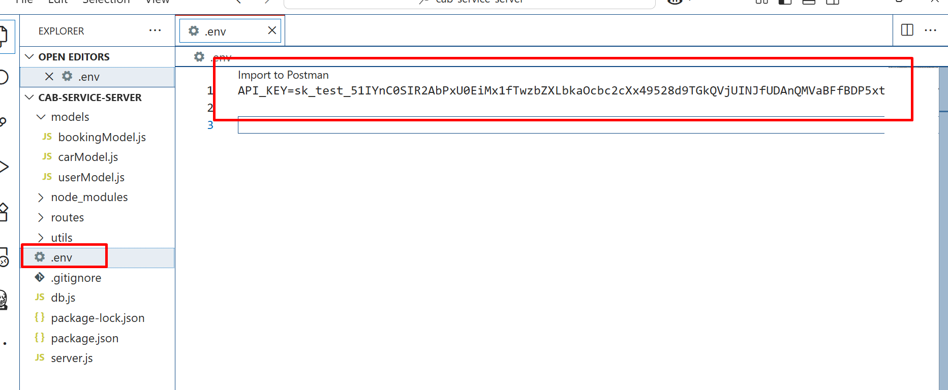
Please add dummy secret key
Open .evn file
add the secret key. Which help to do duppy payment.

Slide 27
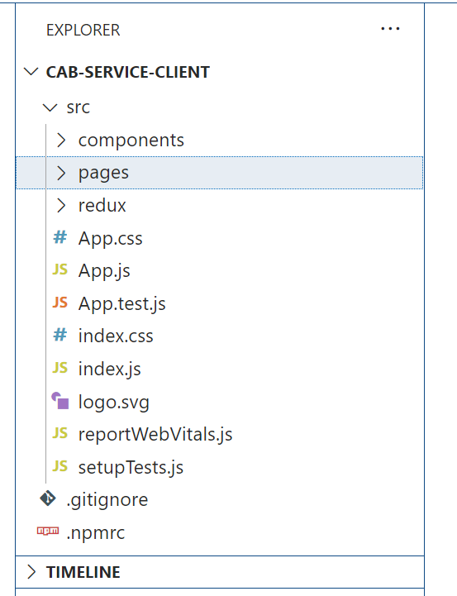
Front – react js project

Slide 28
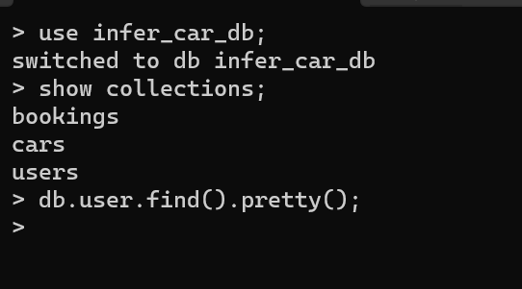
Database is mongo db
open the mongo db terminal

Slide 29
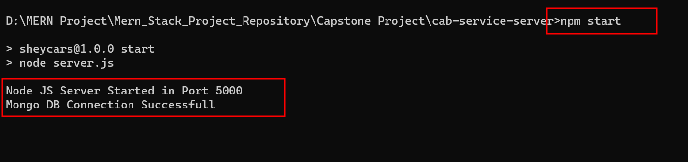
Now run the backend technology
Using the command as
npm start

Slide 30
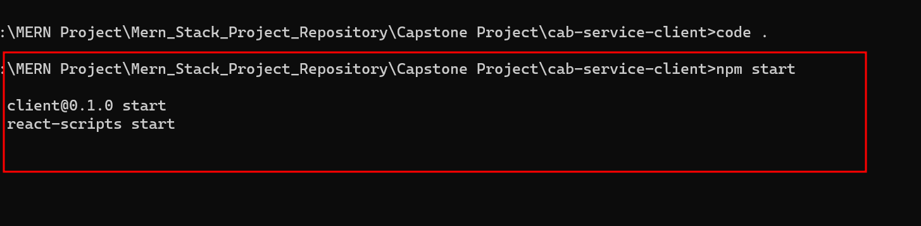
Now run the frontend technology
npm start

Slide 31
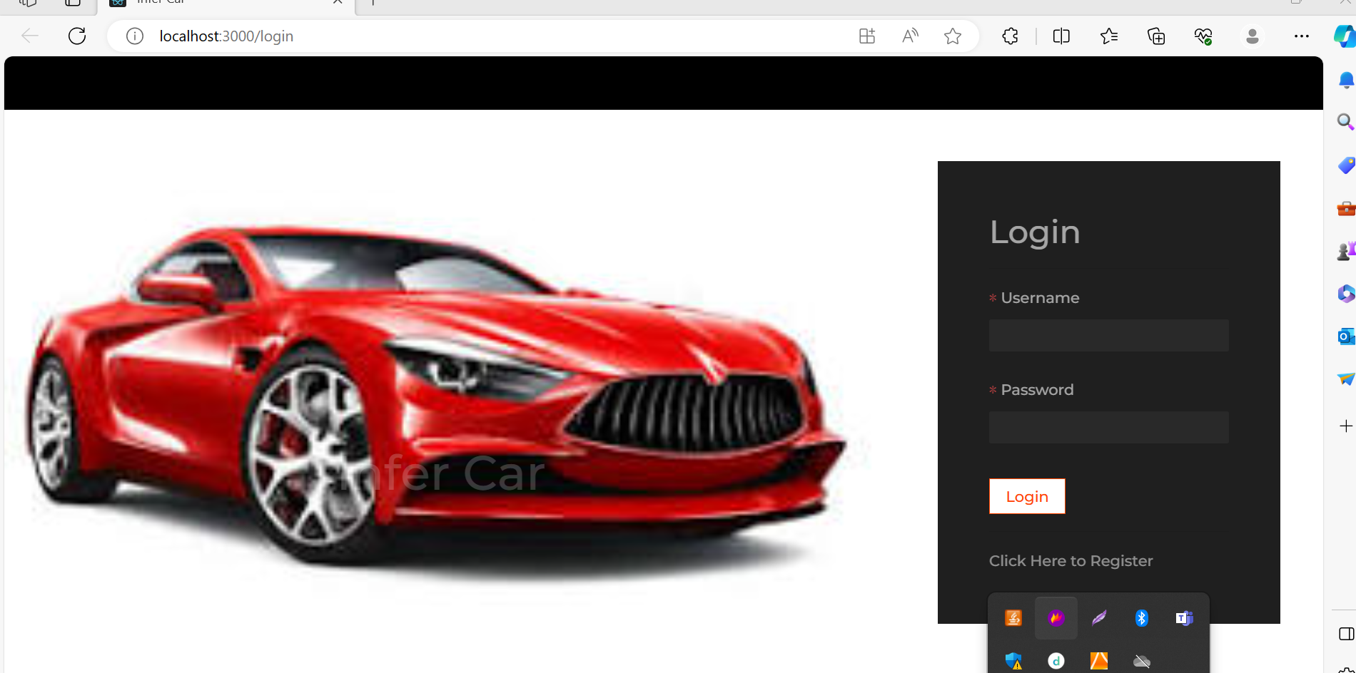

Slide 32
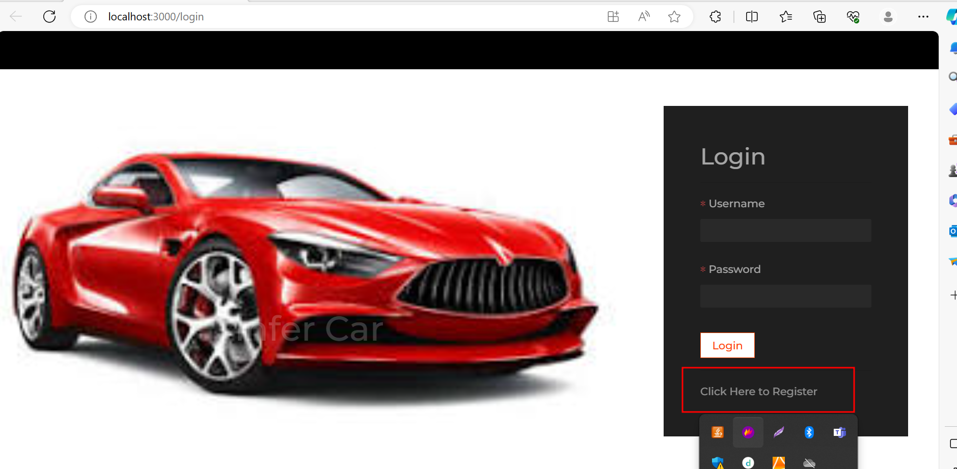
Now you do registration

Slide 33
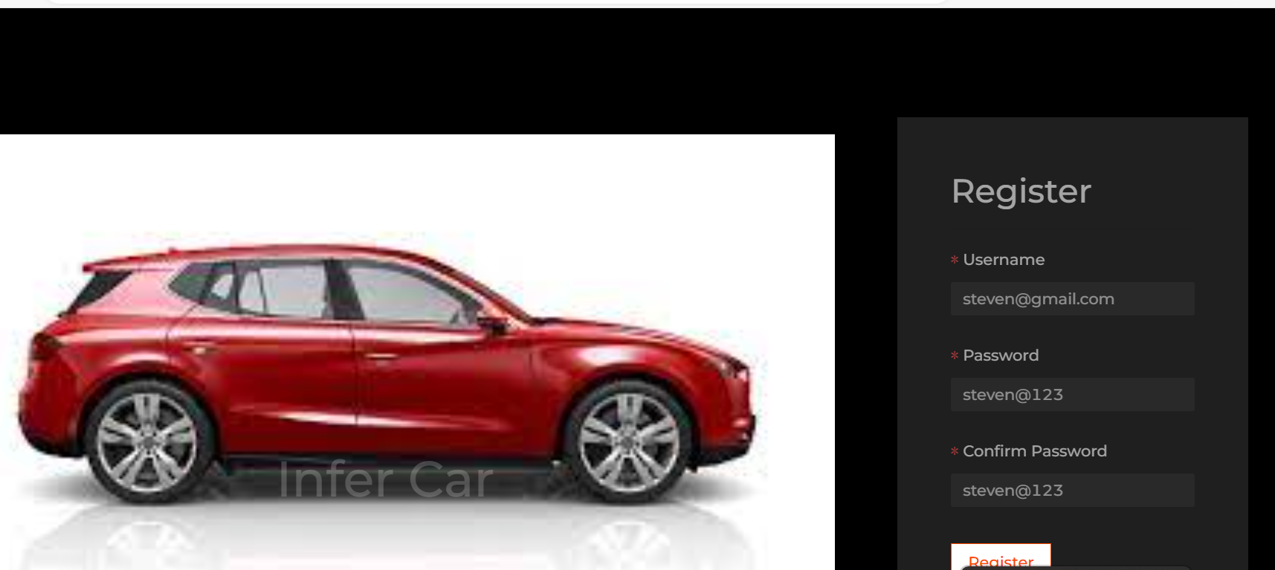

Slide 34
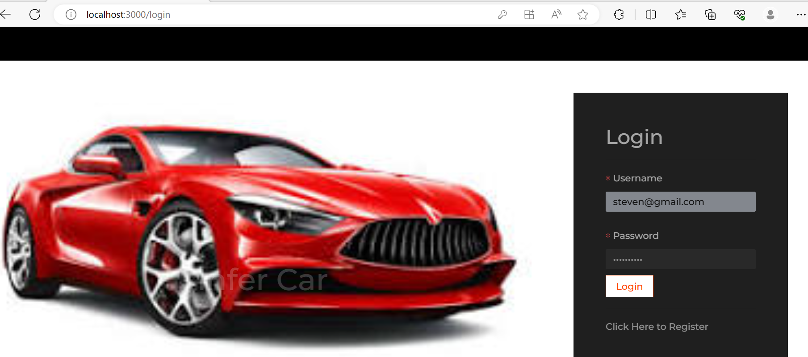
After registration you can do the login

Slide 35
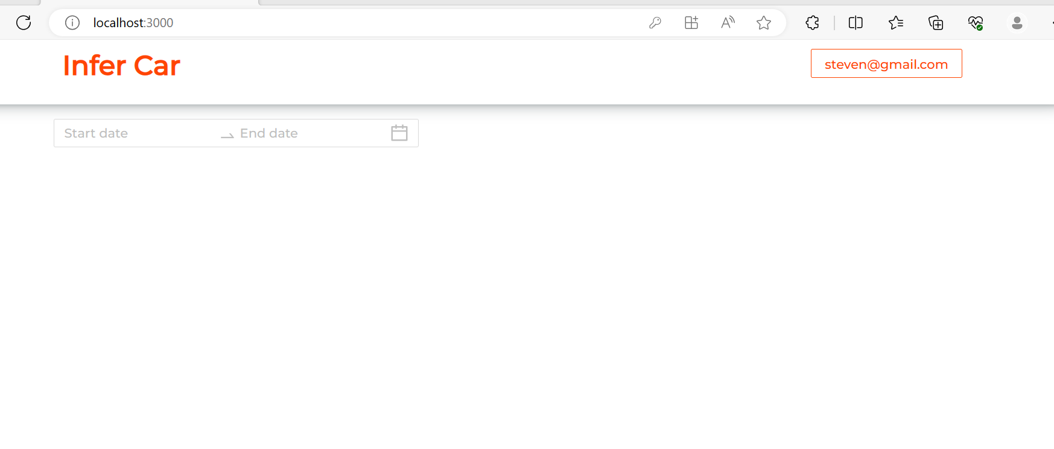
Dashboard

Slide 36
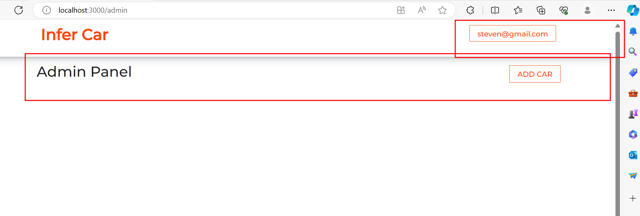
Using admin panel you can add the new cabs.

Slide 37
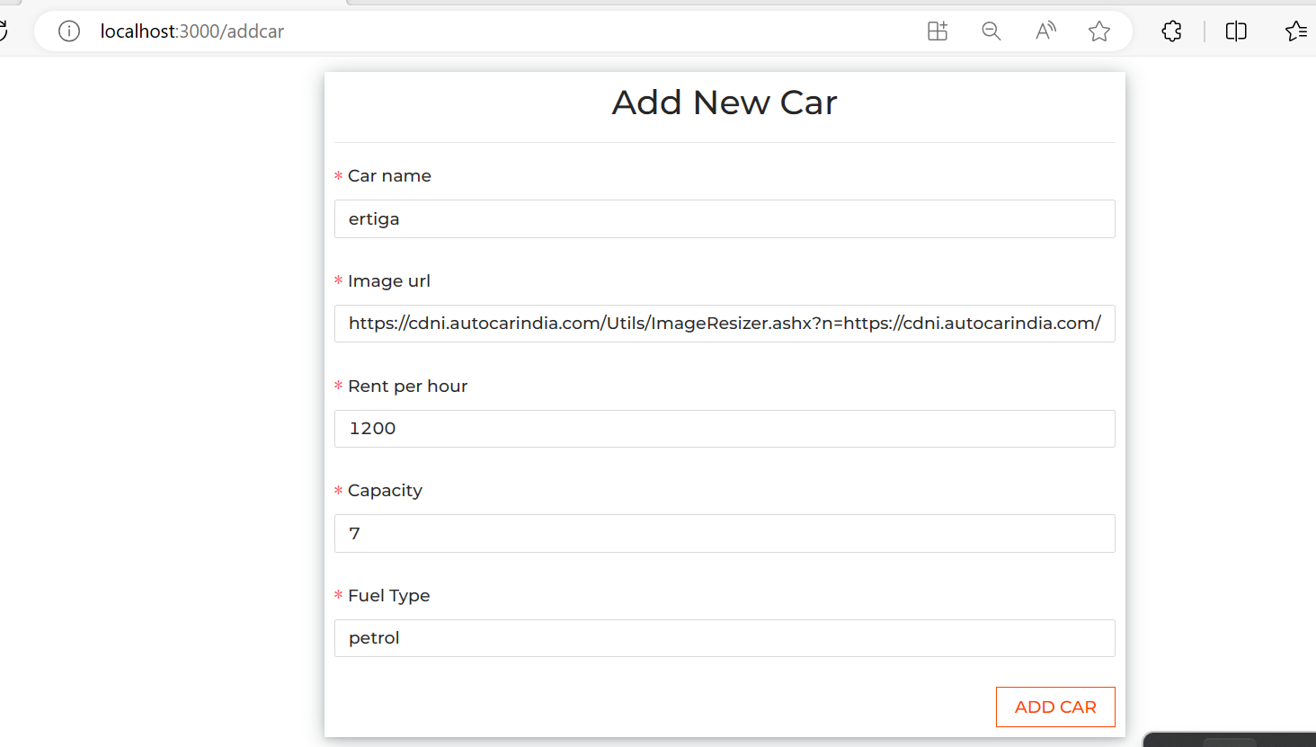
Add the car

Slide 38
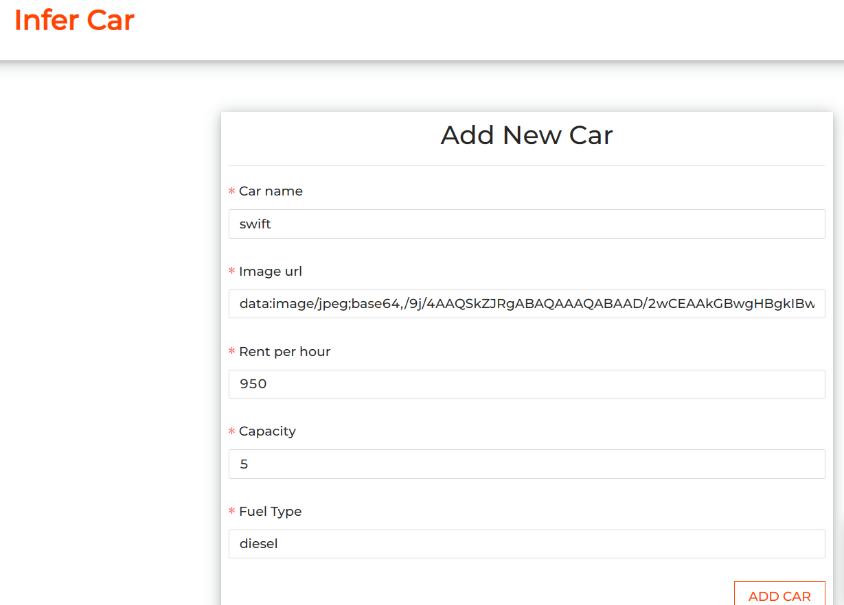
Add the car

Slide 39
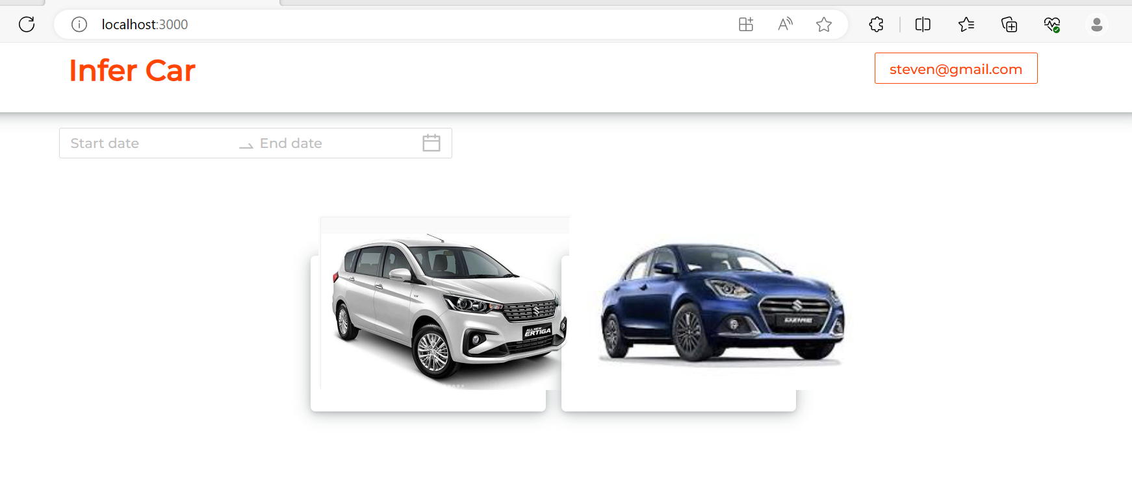
After added cars

Slide 40
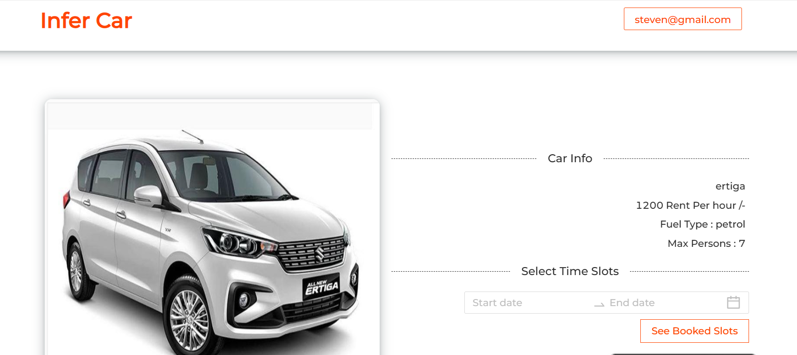
Now you can book the cab

Slide 41
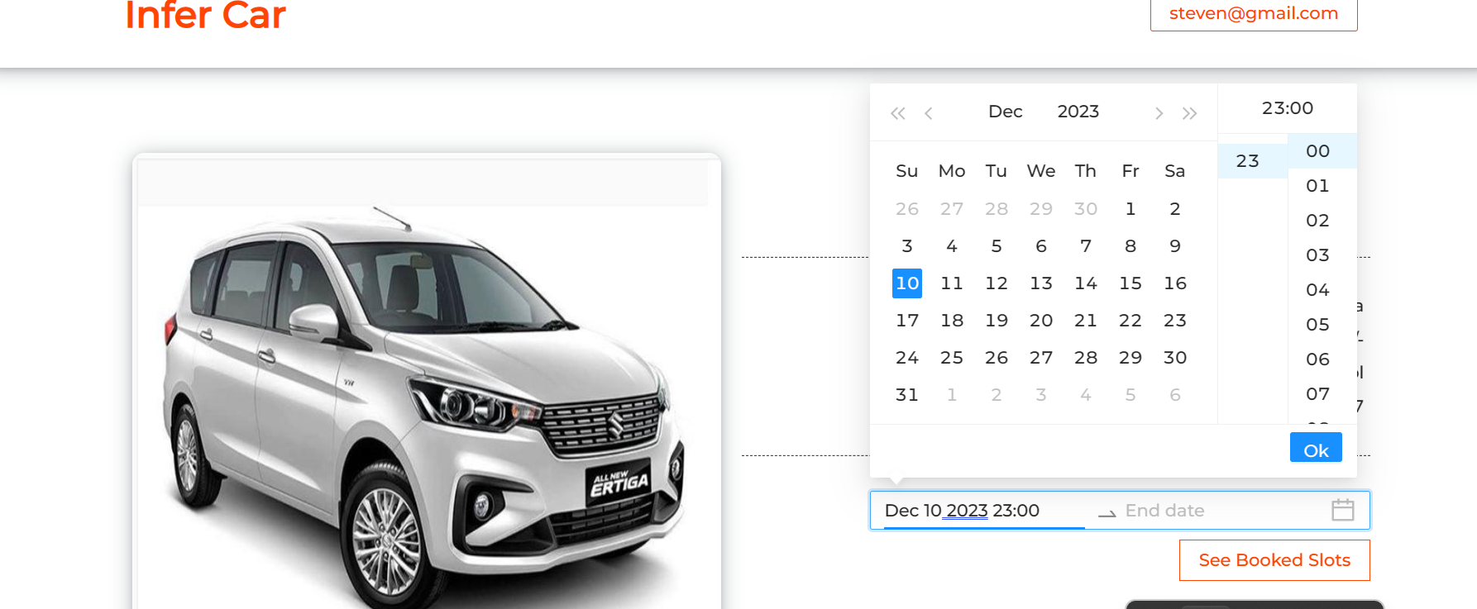
Please provide start date

Slide 42
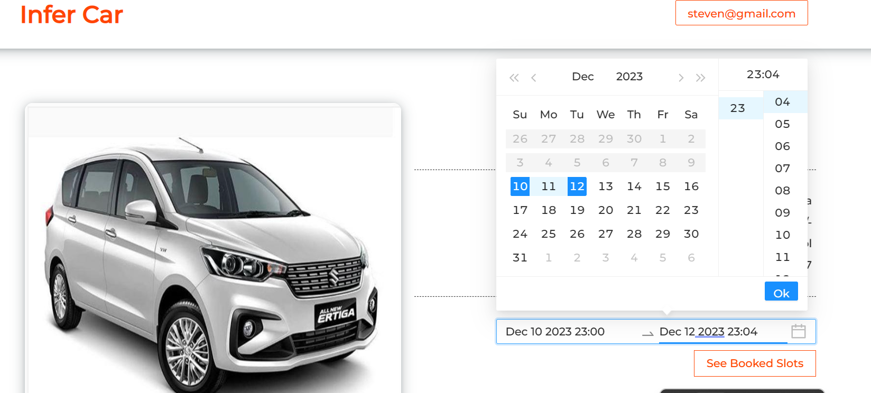
Please provide end date

Slide 43
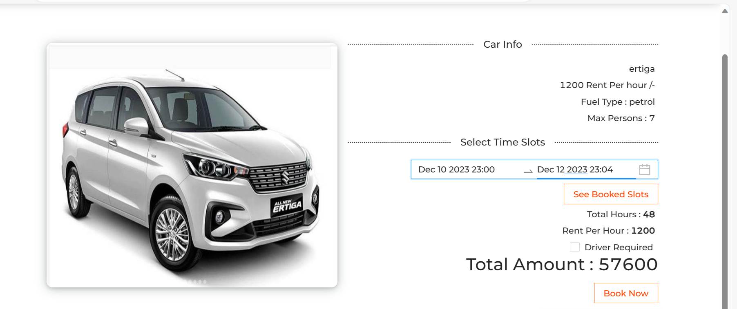
After selected date you can see details

Slide 44
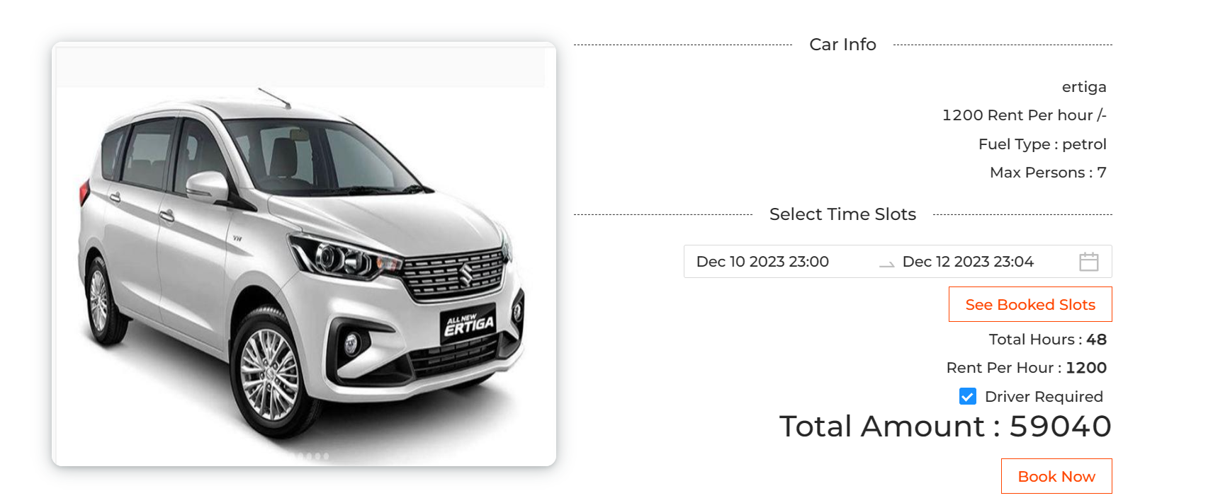
You can select the driver

Slide 45
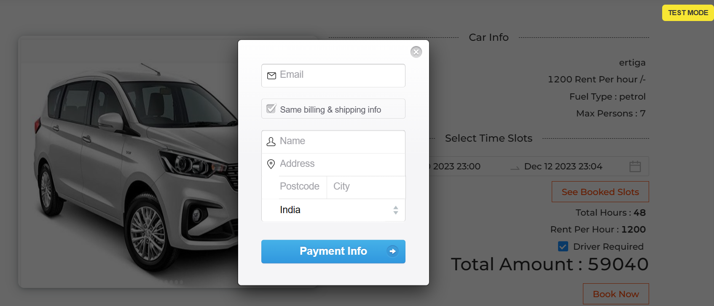
Once you click on book now it will open payment details page

Slide 46
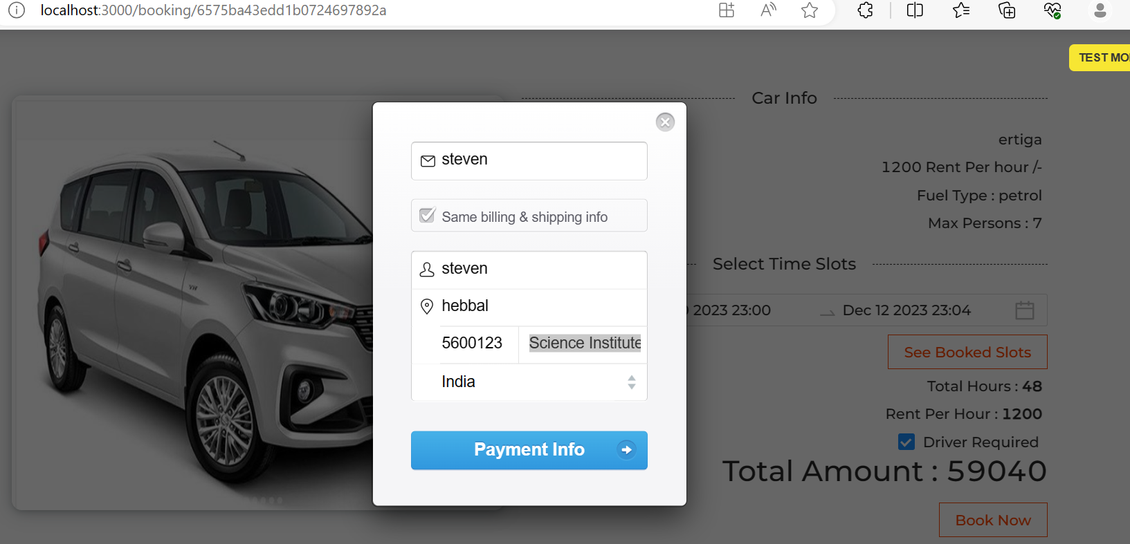
It will check information from live url

Slide 47
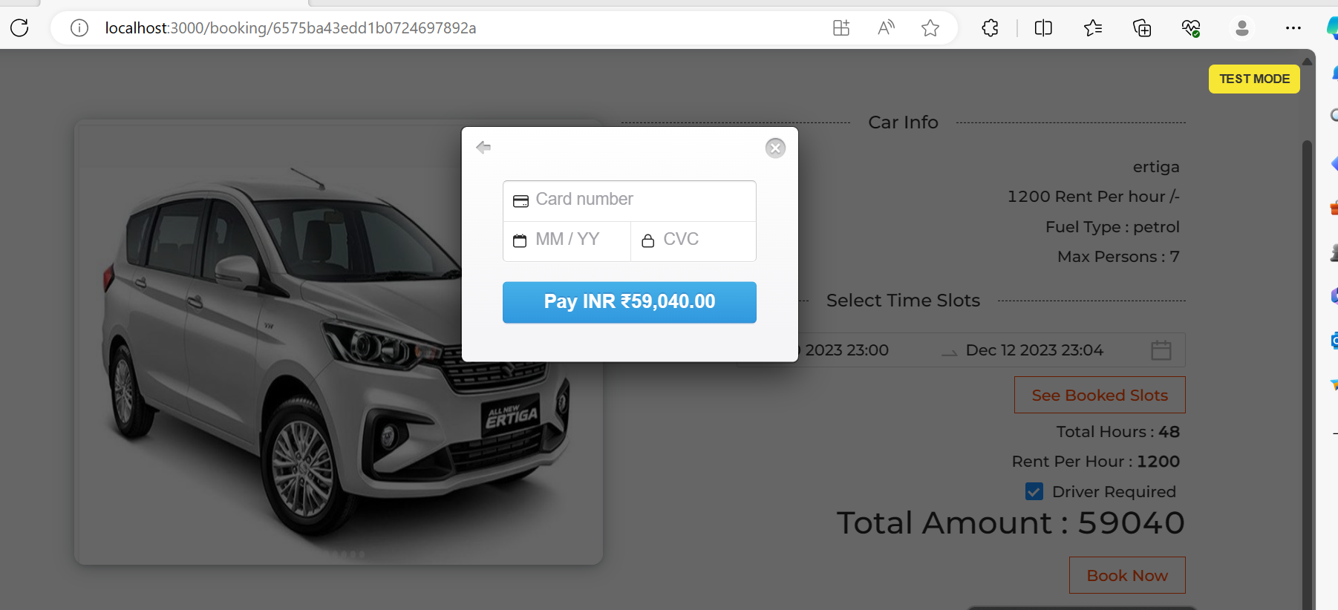
This payment is test mode

Slide 48
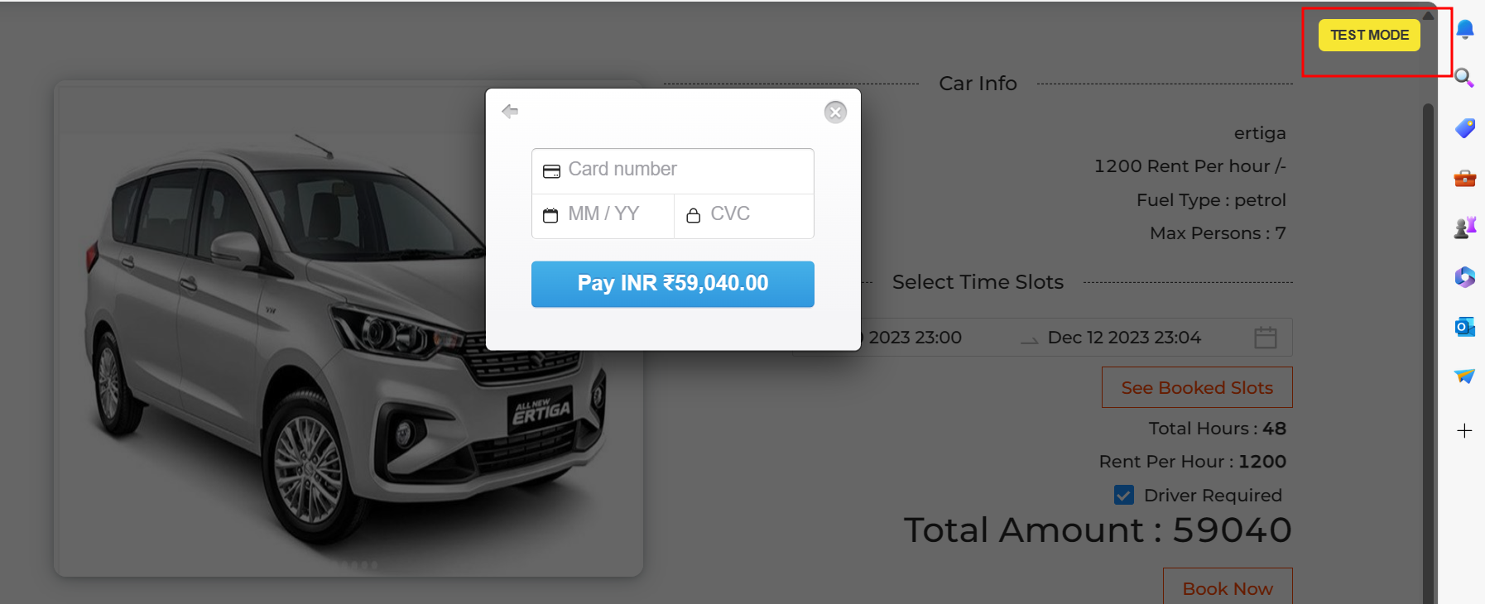
Please click on test model button

Slide 49
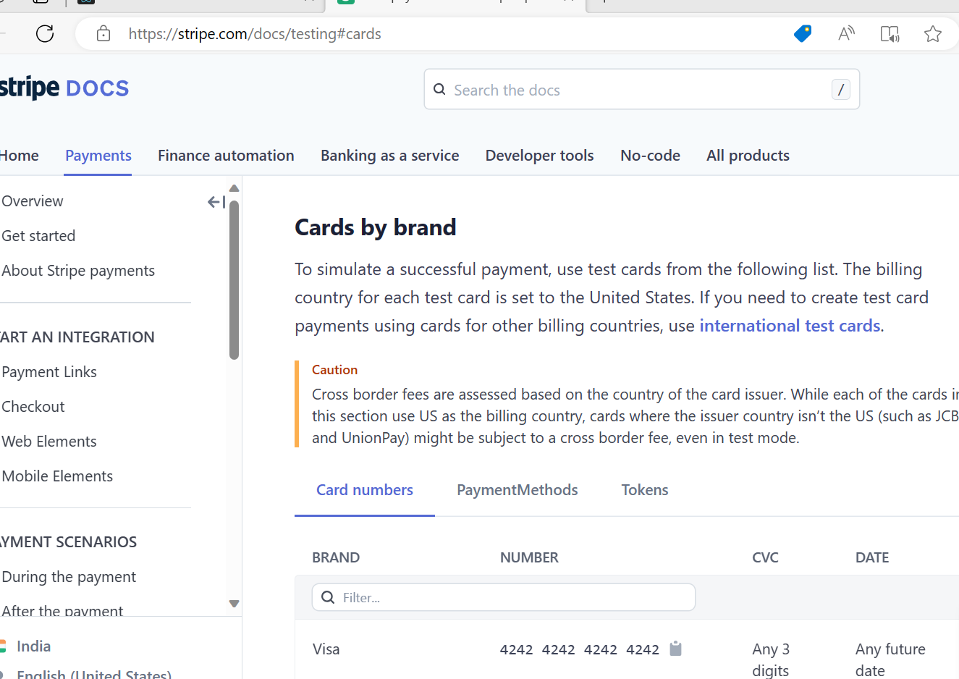
This is use stripe website

Slide 50
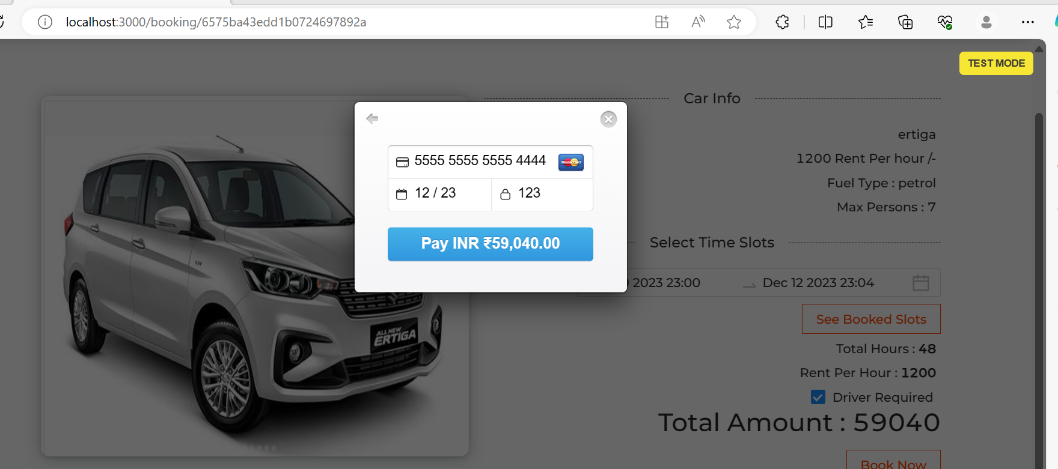
From this document you can get duppy card details to do the payment like a real time payment

Slide 51
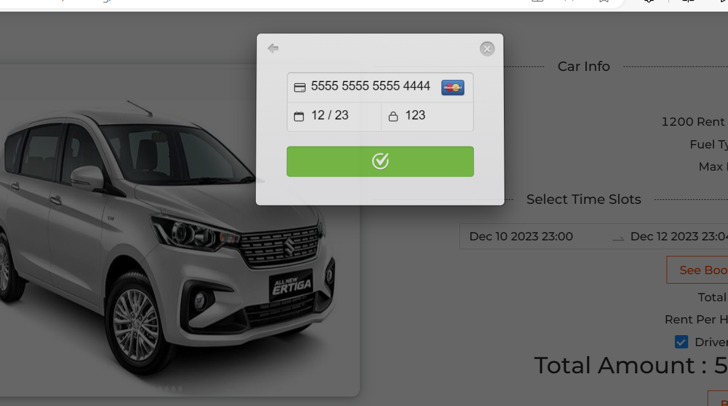
After click on payment

Slide 52
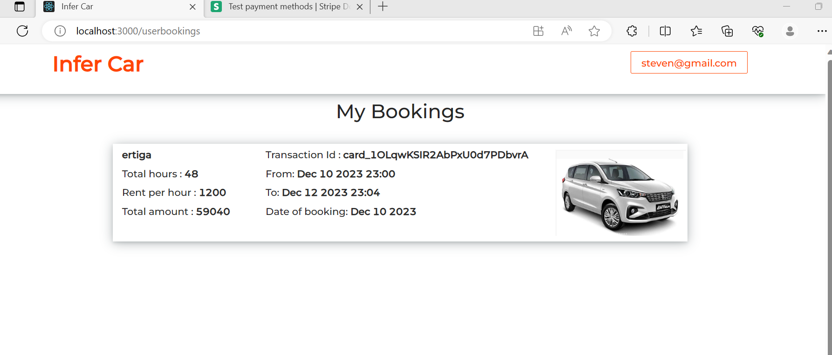
You can see the booking details

Slide 53
Adding Gen AI tool features to existing project

Slide 54
Phase 1 : AI-Assisted UI
Tools: Uizard

Slide 55
Step-by-Step: Upload React Login Page to Uizard and Enhance UI (Free Tier)
Capture Your React Component as an Image
You need a screenshot of your login component:
Open your app in the browser.
Press PrtSc or use Snipping Tool / Snip & Sketch to take a screenshot.
Save it as a .png or .jpg.

Slide 56
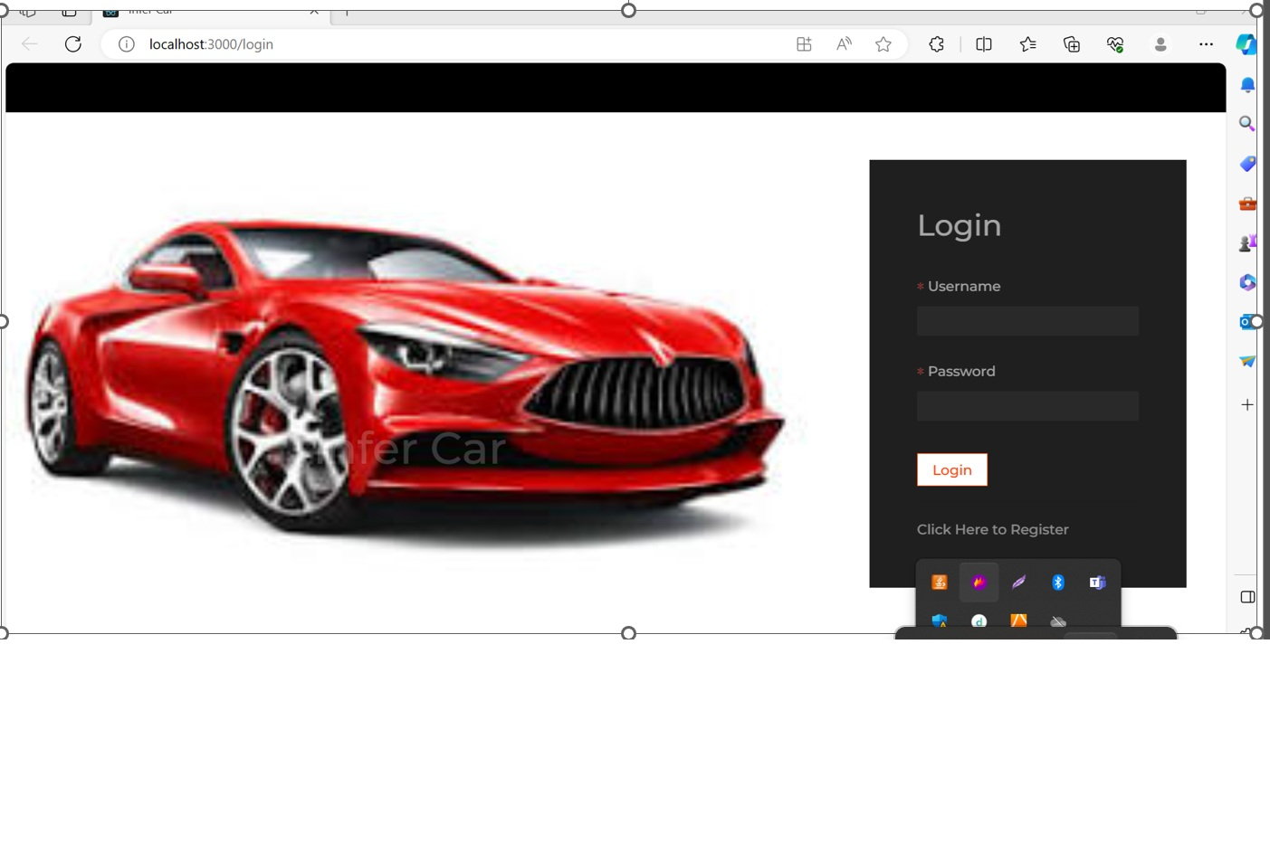

Slide 57
Go to Uizard and Start a Project
Visit: https://uizard.io
Sign up or log in (free account)
Click on “Start from screen short”
Choose: Screen short scanner
Select “in prompt message select the desktop”
It will ask you to upload the image.

Slide 58
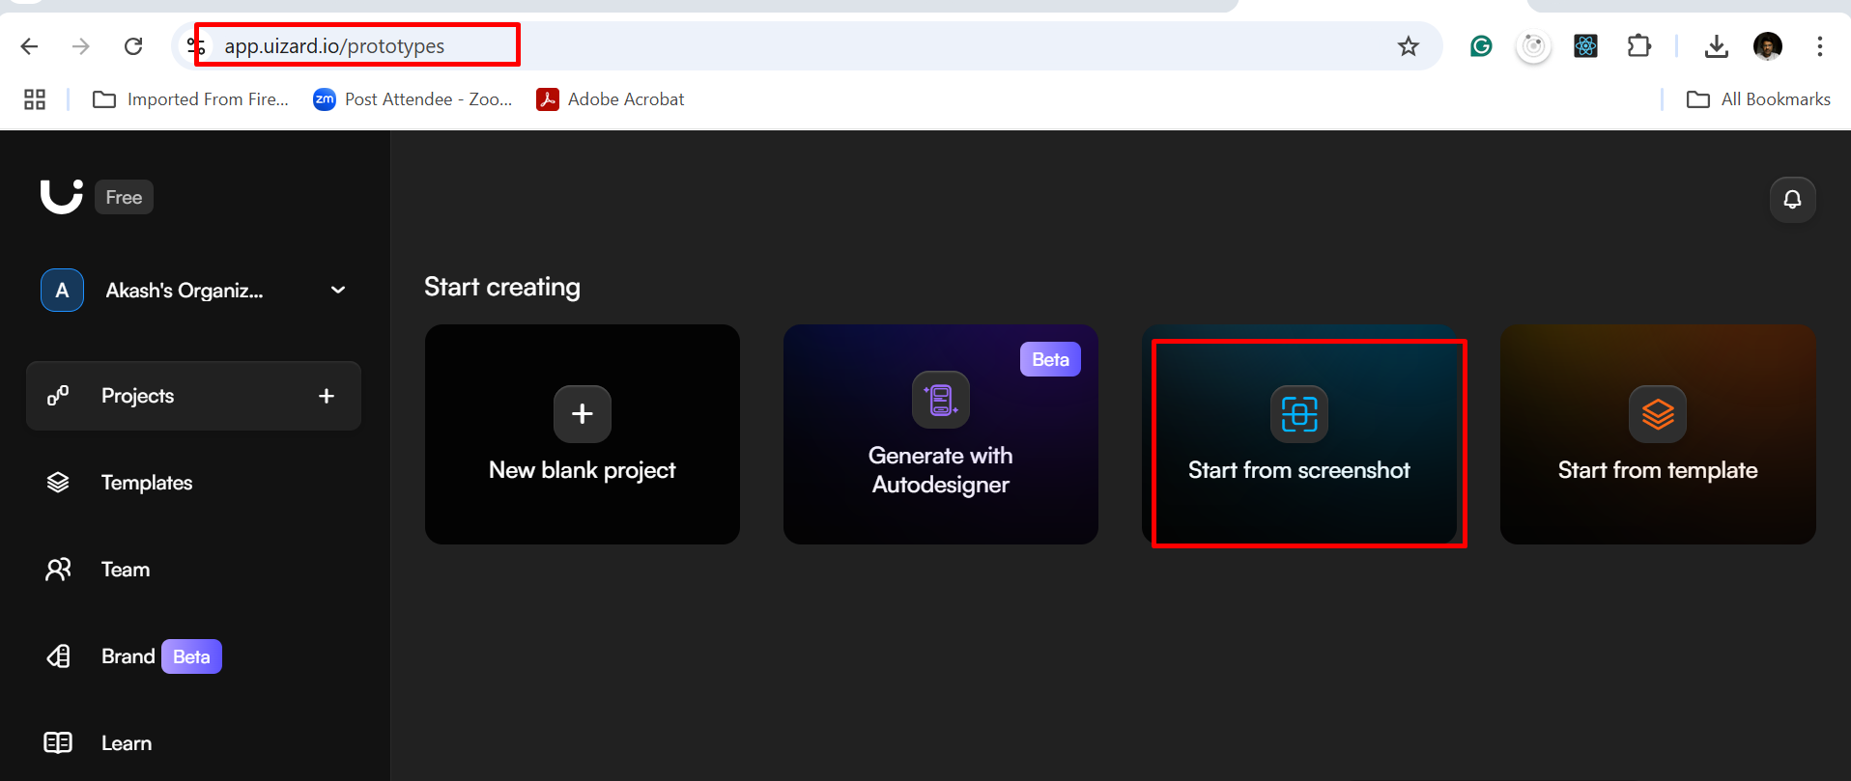

Slide 59
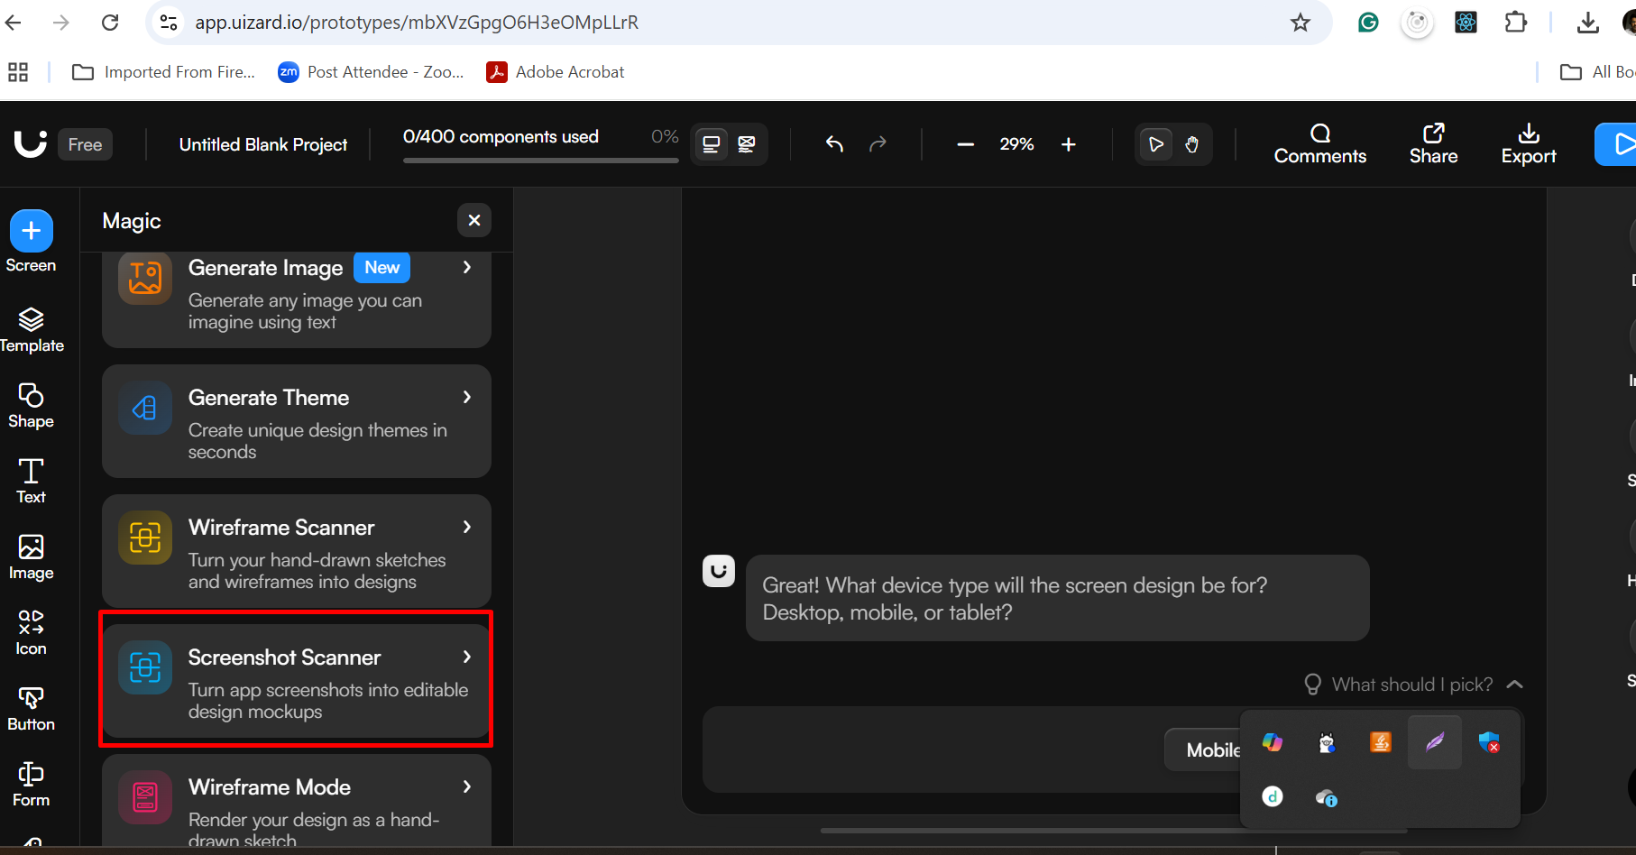

Slide 60
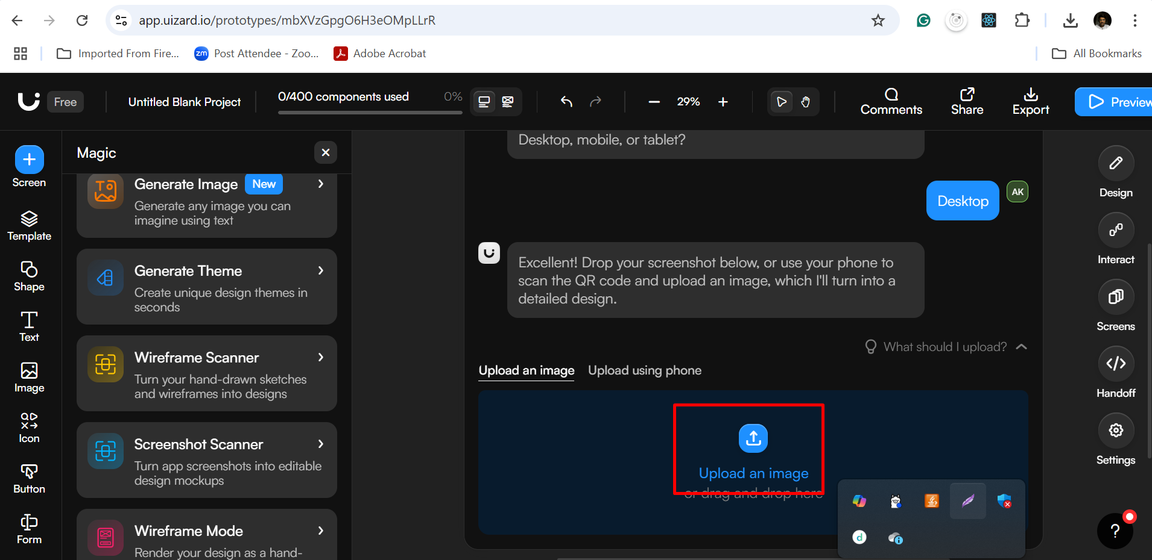

Slide 61
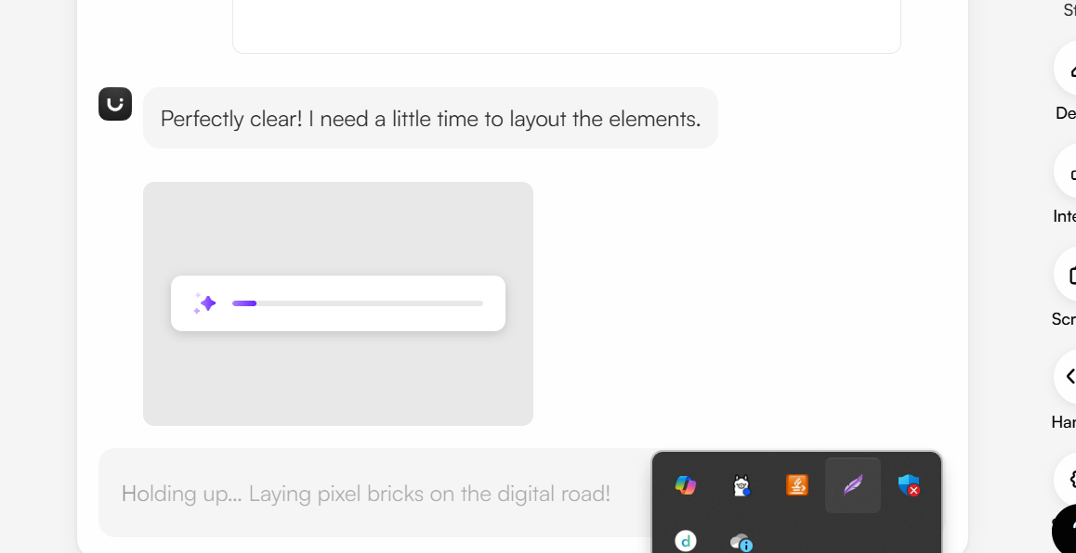

Slide 62
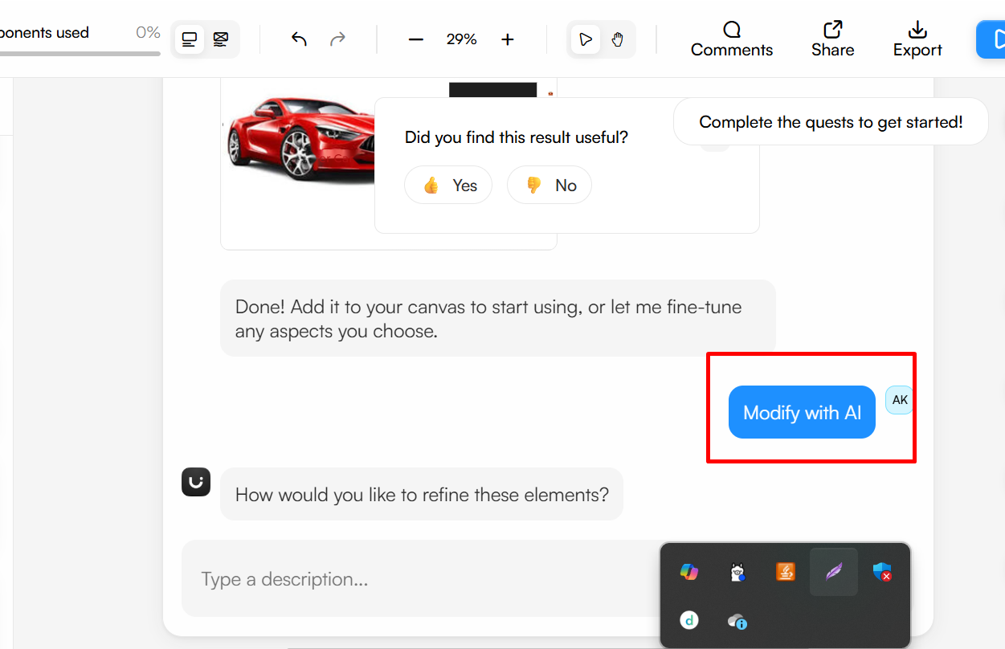

Slide 63
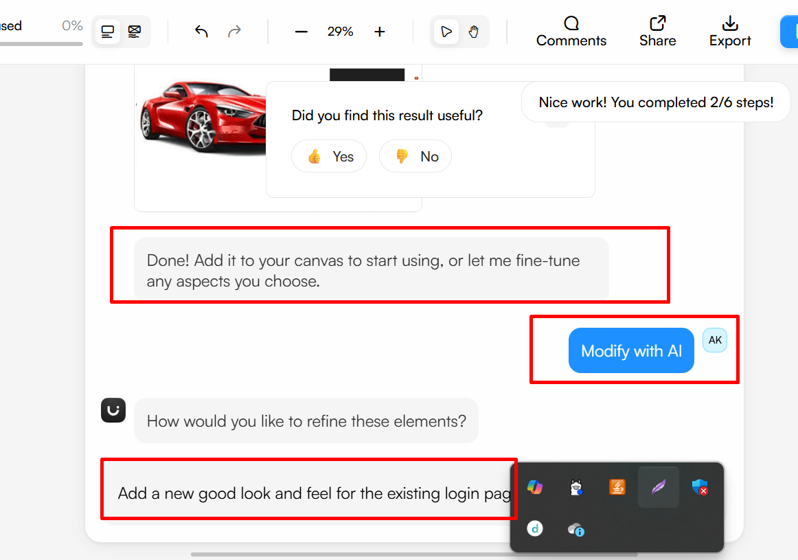

Slide 64
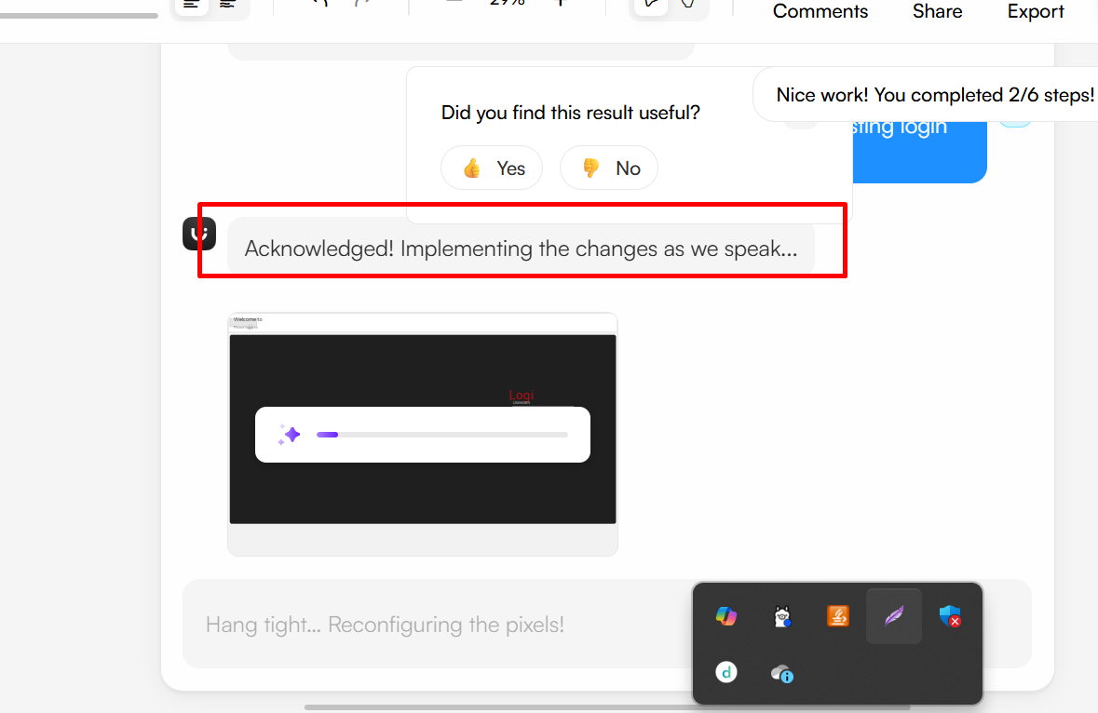

Slide 65
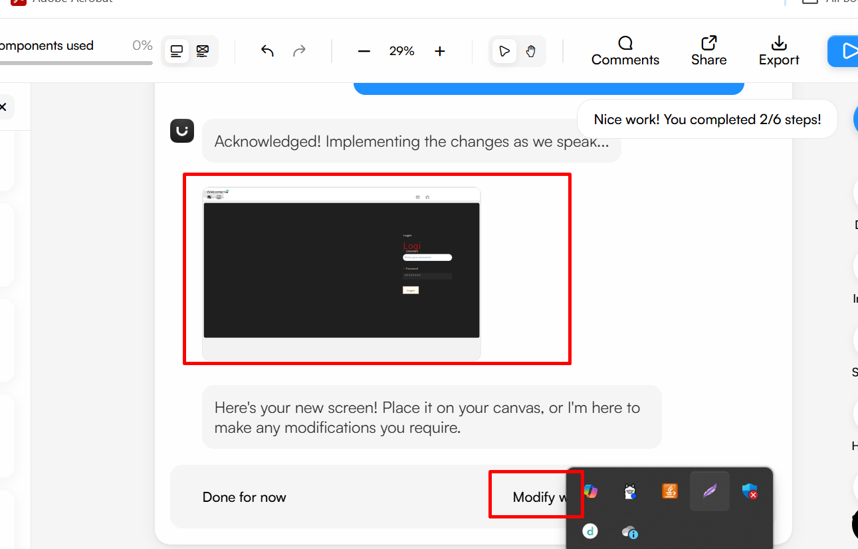

Slide 66
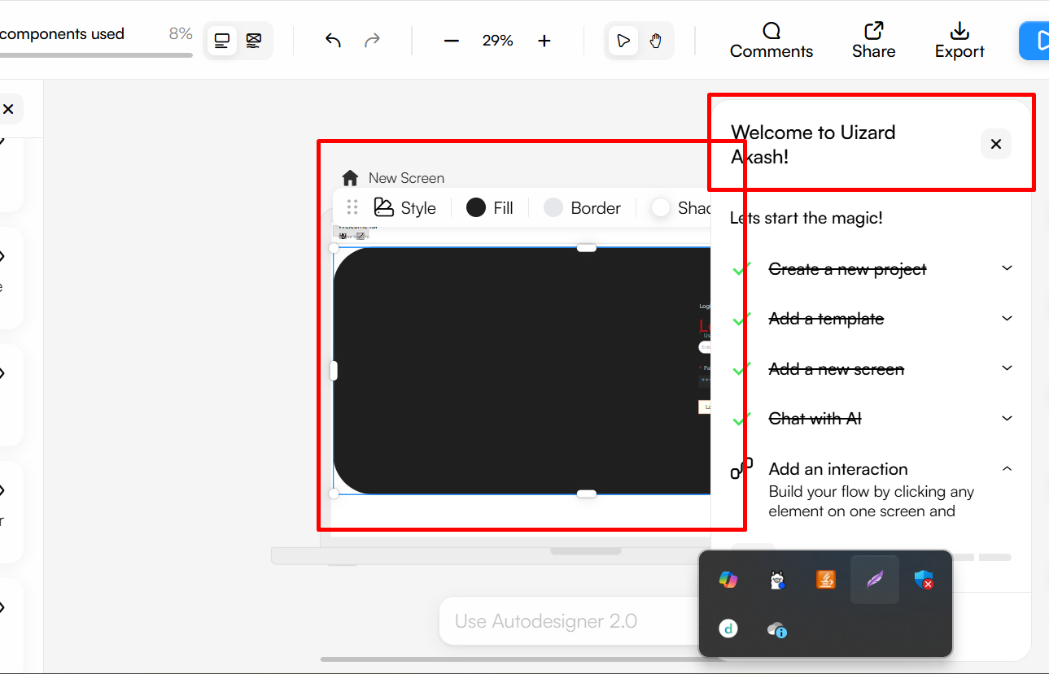

Slide 67
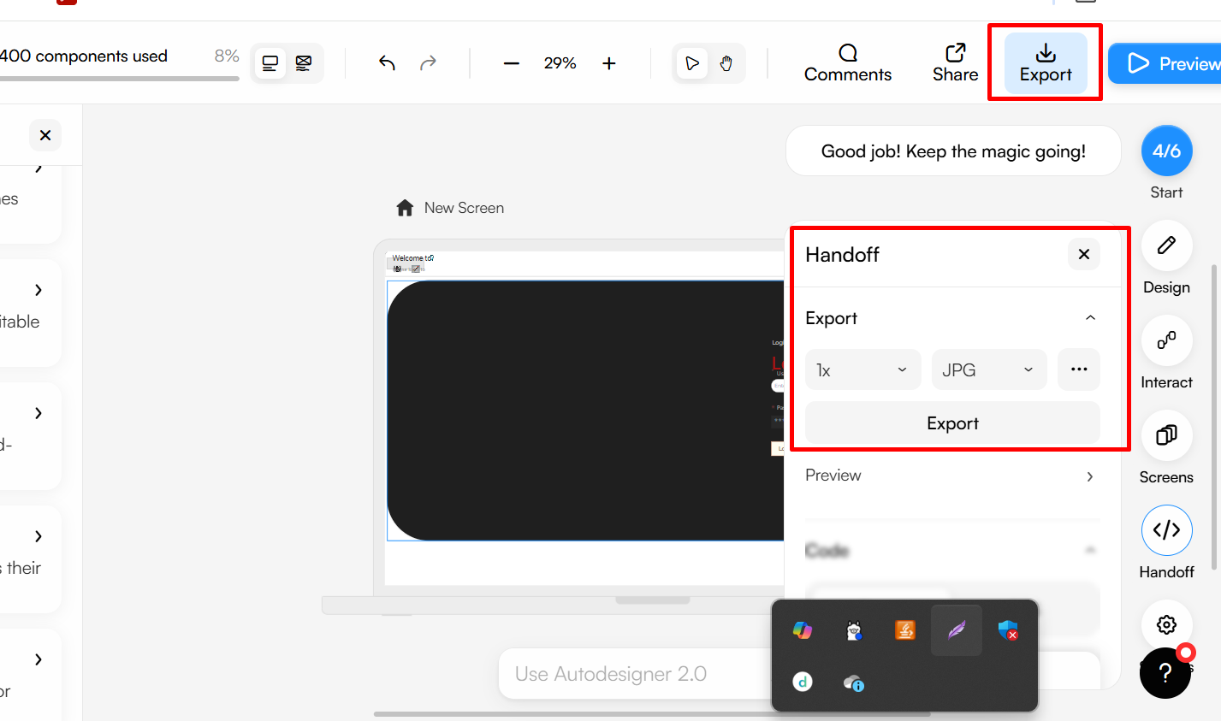

Slide 68
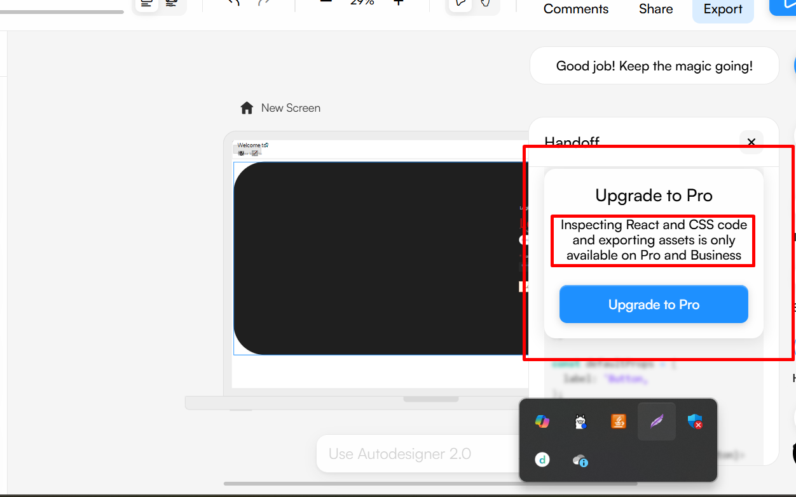

Slide 69
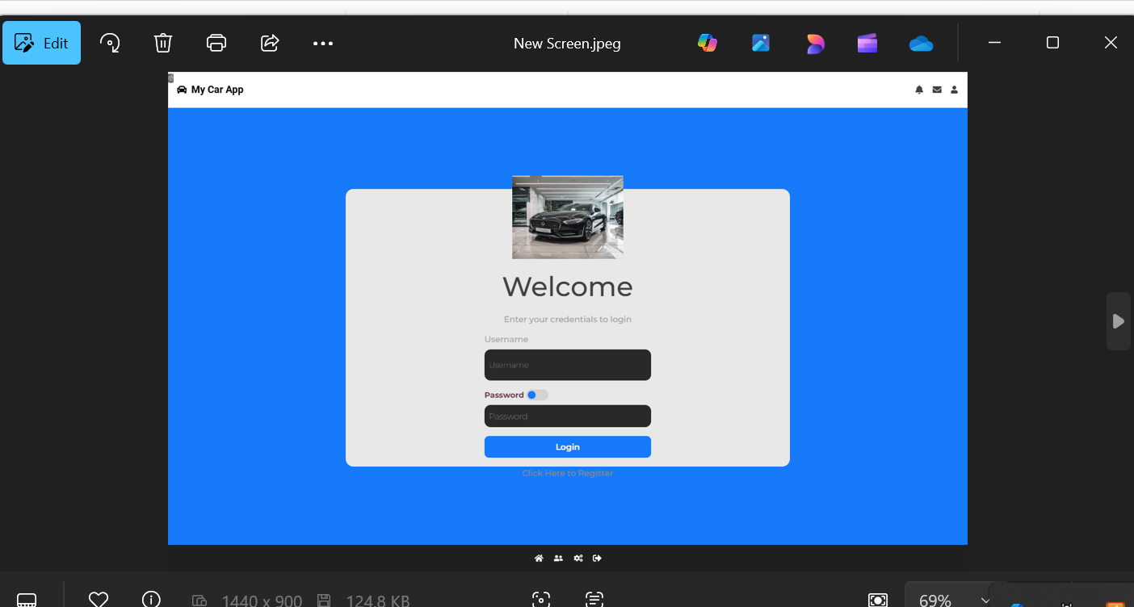

Slide 70
Phase 2 : AI-Assisted Development
Tools: GitHub Copilot, ChatGPT

Slide 71
Enable GitHub Copilot in VS Code.
Start typing your React components, routes, or backend service methods.
E.g., Type getCabAvailability = async () => → Copilot suggests logic automatically.

Slide 72
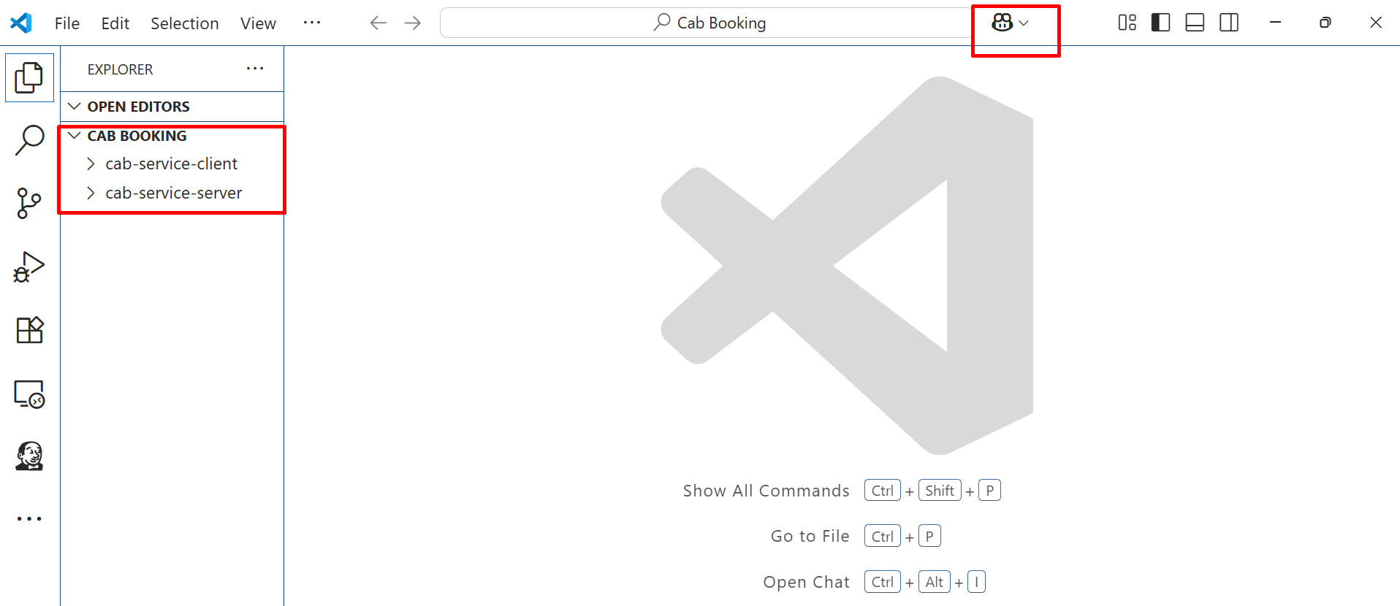

Slide 73


Slide 74


Slide 75


Slide 76


Slide 77


Slide 78


Slide 79


Slide 80


Slide 81


Slide 82
Now run the application and test it

Slide 83


Slide 84
Now apply this code to Home.js file and test it.

Slide 85


Slide 86
ChatGPT tools

Slide 87
Use ChatGPT prompts like
“Generate Mongoose schema for car booking with carId, userId, startDate, endDate.”
“React component for selecting a car and making a Stripe payment.”

Slide 88


Slide 89


Slide 90


Slide 91


Slide 92


Slide 93


Slide 94


Slide 95


Slide 96
AI to optimize or rewrite existing logic of backend or frontend technologies

Slide 97


Slide 98


Slide 99


Slide 100


Slide 101


Slide 102
npm install moment
Then test the code

Slide 103
Code Optimization & Documentation
Tools : GitHub Copilot and Chat GPT

Slide 104


Slide 105


Slide 106


Slide 107


Slide 108


Slide 109


Slide 110
Phase 4: AI-Powered Testing
Tools: TestRigor

Slide 111
TestRigor
Connect your app URL to TestRigor.

Slide 112
Login for Test rigor
Step 1: Sign Up & Log In
Go to https://testrigor.com.
Click “Try it free” or “Sign Up”.
Provide your email address and create a password (or use Google account).
Confirm your email if prompted.

Slide 113


Slide 114


Slide 115


Slide 116


Slide 117


Slide 118


Slide 119


Slide 120


Slide 121
Now we will create test case

Slide 122


Slide 123


Slide 124
Test natural languge
go to "http://localhost:300"
enter "testuser" into "steven@gmail.com"
enter "password123" into "steven@123"
click "Login"
click "Book a Cab"
enter "Mumbai" into "Pickup Location"
enter "Pune" into "Drop Location"
click "Search"
click "Select" on the first car
click "Proceed to Payment"
enter card number "4242 4242 4242 4242"
enter expiry "12/28"
enter CVV "123"
click "Pay"
check that page contains "Booking Confirmed"

Slide 125

Here we will get the error. Because our application running locally. If run on cloud or develop then we can test very easily

Slide 126

You can generate sample test case

Slide 127

Now click on actual test generate by AI

